Slide 1
Fit and Transform

Slide 2
Data Rescaling
Data must be prepared before you can build models. The data preparation process can involve three steps: data selection, data preprocessing and data transformation.
Your preprocessed data may contain attributes with a mixtures of scales for various quantities such as dollars, kilograms and sales volume.
Many machine learning algorithms perform better when numerical input variables are scaled to a standard range. Scaling the data means it helps to Normalize the data within a particular range.

Slide 3
Scikit Learn Methods for Scaling
MinMaxScaler, RobustScaler, StandardScaler, and Normalizer are Scikit Learn methods to preprocess data for machine learning.
Which method you need, if any, depends on your model type and your feature values.

Slide 4
Why Scale, Standardize, or Normalize?
Many machine learning algorithms perform better or converge faster when features are on a relatively similar scale and/or close to normally distributed. Examples of such algorithm families include:
linear and logistic regression
nearest neighbors
neural networks
support vector machines with radial bias kernel functions
principal components analysis
linear discriminant analysis
Scaling and standardizing can help features arrive in more digestible form for these algorithms.

Slide 5
Data Normalization
Normalization refers to rescaling real valued numeric attributes into the range 0 and 1.
Normalization requires that you know or are able to accurately estimate the minimum and maximum observable values.
It is useful to scale the input attributes for a model that relies on the magnitude of values, such as distance measures used in k-nearest neighbors and in the preparation of coefficients in regression.
The example demonstrates data normalization of the Iris flowers dataset.
# Normalize the data attributes for the Iris dataset.
from sklearn.datasets import load_iris
from sklearn import preprocessing
# load the iris dataset
iris = load_iris()
print(iris.data.shape)
# separate the data from the target attributes
X = iris.data
y = iris.target
# normalize the data attributes
normalized_X = preprocessing.normalize(X)

Slide 6
Scikit-learn Methods
Two popular data scaling methods are normalization and standardization.
The following methods are in sklearn.preprocessing
MinMaxScalar for Normalisation
StandardScalar for Standardization
MinMaxScaler is also known as Normalization and it transform all the values in range between (0 to 1)
x = [(value - min)/(Max- Min)]
StandardScaler comes under Standardization and its value ranges between (-3 to +3)
z = [(x - x.mean)/Std_deviation]

Slide 7
MinMaxScaler
MinMaxScaler transforms each value in the column proportionally within the range [0,1].
This must be the first scaler choice to transform a feature, as it will preserve the shape of the dataset (no distortion).
MinMaxScaler doesn’t reduce the importance of outliers.
MinMaxScaler is a good place to start unless you know you want your feature to have a normal distribution or want outliers to have reduced influence.

Slide 8
Data Normalization Using MinMaxScaler
Fit the scaler using available training data. For normalization, this means the training data will be used to estimate the minimum and maximum observable values. This is done by calling the fit() function.
Apply the scale to training data. This means you can use the normalized data to train your model. This is done by calling the transform() function.
Apply the scale to data going forward. This means you can prepare new data in the future on which you want to make predictions.

Slide 9
Data Normalization
A value is normalized as follows:
y = (x – min) / (max – min)
Where the minimum and maximum values pertain to the value x being normalized.
For example, for a dataset, we could guesstimate the min and max observable values as 30 and -10. We can then normalize any value, like 18.8, as follows:
y = (x – min) / (max – min)
y = (18.8 – (-10)) / (30 – (-10))
y = 28.8 / 40
y = 0.72

Slide 10
Example of a normalization
# from numpy import asarray
from sklearn.preprocessing import MinMaxScale
data = asarray([[100, 0.001],
[8, 0.05],
[50, 0.005],
[88, 0.07],
[4, 0.1]])
scaler = MinMaxScaler()
# transform data
scaled = scaler.fit_transform(data)
print(scaled)
# convert the array back to a dataframe
dataset = DataFrame(data)
# summarize
print(dataset.describe())
The scaler is defined, fit on the whole dataset and then used to create a transformed version of the dataset with each column normalized independently.

Slide 11
Standardization
StandardScaler() will transform each value in the column to range about the mean 0 and standard deviation 1, ie, each value will be normalised by subtracting the mean and dividing by standard deviation.
Use StandardScaler if you know the data distribution is normal, ie, the observations fit a Gaussian distribution (bell curve) with a well-behaved mean and standard deviation.
The ultimate goal to perform standardization is to bring down all the features to a common scale without distorting the differences in the range of the values.

Slide 12
Data standardization
Data standardization is the process of rescaling the attributes so that they have mean as 0 and variance as 1.
The ultimate goal to perform standardization is to bring down all the features to a common scale without distorting the differences in the range of the values.
In sklearn.preprocessing.StandardScaler(), centering and scaling happens independently on each feature.
Subtracting the mean from the data is called centering, whereas dividing by the standard deviation is called scaling. As such, the method is sometime called “center scaling“.
StandardScaler results in a distribution with a standard deviation equal to 1. The variance is equal to 1 also, because variance = standard deviation squared. And 1 squared = 1.
StandardScaler makes the mean of the distribution 0. About 68% of the values will lie be between -1 and 1.
# Standardize the data attributes for the Iris dataset.
from sklearn.datasets import load_iris
from sklearn import preprocessing
# load the Iris dataset
iris = load_iris()
print(iris.data.shape)
# separate the data and target attributes
X = iris.data
y = iris.target
# standardize the data attributes
standardized_X = preprocessing.scale(X)

Slide 13

Data standardization
The magical formula which performs standardization:

Slide 14
Data standardization
A value is standardized as follows:
y = (x – mean) / standard_deviation
Where the mean is calculated as:
mean = sum(x) / count(x)
And the standard_deviation is calculated as:
standard_deviation = sqrt( sum( (x – mean)^2 ) / count(x))
We can guesstimate a mean of 10.0 and a standard deviation of about 5.0. Using these values, we can standardize the first value of 20.7 as follows:
y = (x – mean) / standard_deviation
y = (20.7 – 10) / 5
y = (10.7) / 5
y = 2.14

Slide 15
Example of a standardization
from numpy import asarray
from sklearn.preprocessing import StandardScaler
# define data
data = asarray([[100, 0.001],
[8, 0.05],
[50, 0.005],
[88, 0.07],
[4, 0.1]])
print(data)
# define standard scaler
scaler = StandardScaler()
# transform data
scaled = scaler.fit_transform(data)
print(scaled)

Slide 16
# evaluate knn on the raw sonar dataset
from numpy import mean
from numpy import std
from pandas import read_csv
from sklearn.model_selection import cross_val_score
from sklearn.model_selection import RepeatedStratifiedKFold
from sklearn.neighbors import KNeighborsClassifier
from sklearn.preprocessing import LabelEncoder
from matplotlib import pyplot
# load dataset
url = "https://raw.githubusercontent.com/jbrownlee/Datasets/master/sonar.csv"
dataset = read_csv(url, header=None)
data = dataset.values
# separate into input and output columns
X, y = data[:, :-1], data[:, -1]
# ensure inputs are floats and output is an integer label
X = X.astype('float32')
y = LabelEncoder().fit_transform(y.astype('str'))
# define and configure the model
model = KNeighborsClassifier()
# evaluate the model
cv = RepeatedStratifiedKFold(n_splits=10, n_repeats=3, random_state=1)
n_scores = cross_val_score(model, X, y, scoring='accuracy', cv=cv, n_jobs=-1, error_score='raise')
# report model performance
print('Accuracy: %.3f (%.3f)' % (mean(n_scores), std(n_scores)))

Slide 17
# evaluate knn on the sonar dataset with standard scaler transform
from numpy import mean
from numpy import std
from pandas import read_csv
from sklearn.model_selection import cross_val_score
from sklearn.model_selection import RepeatedStratifiedKFold
from sklearn.neighbors import KNeighborsClassifier
from sklearn.preprocessing import LabelEncoder
from sklearn.preprocessing import StandardScaler
from sklearn.pipeline import Pipeline
from matplotlib import pyplot
# load dataset
url = "https://raw.githubusercontent.com/jbrownlee/Datasets/master/sonar.csv"
dataset = read_csv(url, header=None)
data = dataset.values
# separate into input and output columns
X, y = data[:, :-1], data[:, -1]
# ensure inputs are floats and output is an integer label
X = X.astype('float32')
y = LabelEncoder().fit_transform(y.astype('str'))
# define the pipeline
trans = StandardScaler()
model = KNeighborsClassifier()
pipeline = Pipeline(steps=[('t', trans), ('m', model)])
# evaluate the pipeline
cv = RepeatedStratifiedKFold(n_splits=10, n_repeats=3, random_state=1)
n_scores = cross_val_score(pipeline, X, y, scoring='accuracy', cv=cv, n_jobs=-1, error_score='raise')
# report pipeline performance
print('Accuracy: %.3f (%.3f)' % (mean(n_scores), std(n_scores)))

Slide 18
Which Method to use?
It is hard to know whether rescaling your data will improve the performance of your algorithms before you apply them.
A good tip is to create rescaled copies of your dataset and race them against each other using your test harness and a handful of algorithms you want to spot check. This can quickly highlight the benefits (or lack there of) of rescaling your data with given models, and which rescaling method may be worthy of further investigation.

Slide 19
fit_transform()
fit_transform() is used on the training data so that we can scale the training data and also learn the scaling parameters of that data.
The fit method calculates the mean and variance of each of the features present in our data and learns them.
These learned parameters are then used to scale our test data.
The transform method then transforms all the features using the respective mean and variance.

Slide 20
transform()
Scaling is applied to the test data too and at the same time without any bias with our model.
The transform method ensures that the test data should be completely new and a surprise set for our model.
This method ensures that the the same mean and variance as it is calculated from our training data is used to transform our test data.
Thus, the parameters learned by our model using the training data will help us to transform our test data.

Slide 21
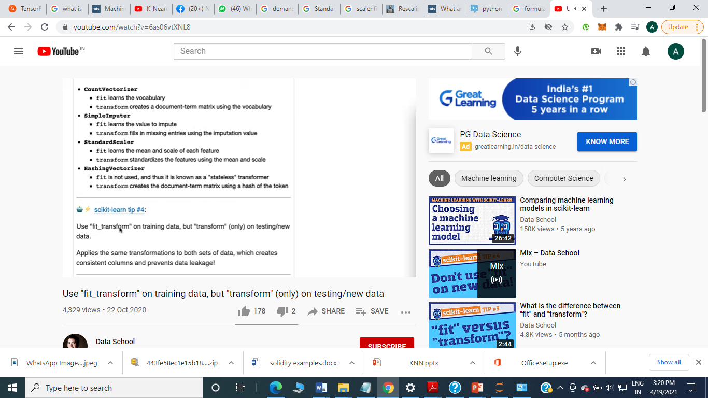
Why only transform on test data?
If we will use the fit method on our test data too, we will compute a new mean and variance that is a new scale for each feature and will let our model learn about our test data too.
Therefore we will not get a good estimate of how our model is performing on the test (unseen) data which is the ultimate goal of building a model using machine learning algorithm.
This is the standard procedure to scale our data while building a machine learning model so that our model is not biased towards a particular feature of the dataset and at the same time prevents our model to learn the features/values/trends of our test data.

Slide 22
Example
# Normalize the data attributes for the Iris dataset.
from sklearn.datasets import load_iris
from sklearn import preprocessing
# load the iris dataset
iris = load_iris()
print(iris.data.shape)
# separate the data from the target attributes
X = iris.data
y = iris.target
# normalize the data attributes
normalized_X = preprocessing.normalize(X)

Slide 23
StandardScaler
StandardScaler follows Standard Normal Distribution (SND). Therefore, it makes mean = 0 and scales the data to unit variance.
MinMaxScaler scales all the data features in the range [0, 1] or else in the range [-1, 1] if there are negative values in the dataset. ... This range is also called an Interquartile range.

Slide 24
StandardScaler
StandardScaler removes the mean and scales the data to unit variance. However, the outliers have an influence when computing the empirical mean and standard deviation which shrink the range of the feature values
StandardScaler therefore cannot guarantee balanced feature scales in the presence of outliers.
MinMaxScaler rescales the data set such that all feature values are in the range [0, 1] as shown in the right panel below. However, this scaling compress all inliers in the narrow range [0, 0.005] for the transformed number of households.

Slide 25
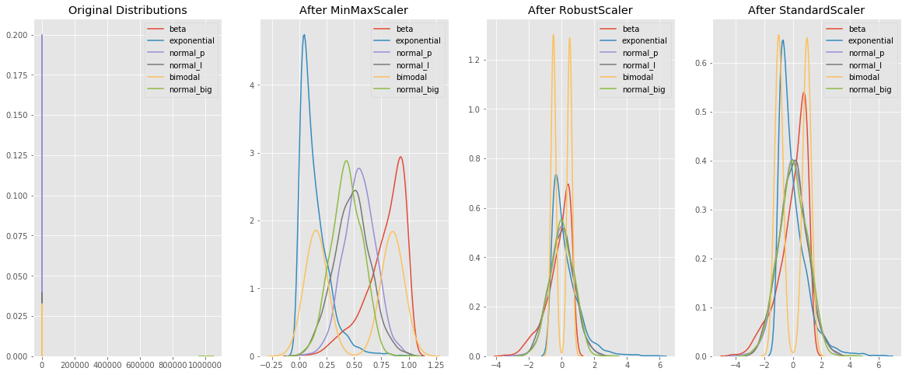
Note that the values are on a similar scale. Also notice that MinMaxScaler doesn’t distort the distances between the values in each feature.

Slide 26
Conclusion
Use MinMaxScaler as the default if you are transforming a feature. It’s non-distorting.
You could use RobustScaler if you have outliers and want to reduce their influence. However, you might be better off removing the outliers, instead.
Use StandardScaler if you need a relatively normal distribution.
Use Normalizer sparingly — it normalizes sample rows, not feature columns. It can use l2 or l1 normalization.

